Slide 1
Colorado College
UMB Bank Procurement Card
New Cardholder Training
Updated June 7, 2018

Slide 2
AGENDA
Introductions
History
P-Card program information
Quiz!
Q&A
UMB Commercial Card demonstration

Slide 3
INTRODUCTIONS
PURCHASING DEPARTMENT
  Anne Corley
  Administrative Services Specialist
  acorley@coloradocollege.edu
  x6695
  available 8:00am-5:00pm
  Monday-Friday

Slide 4
HISTORY
UMB Bank
Jan 2012
900+ cardholders
Average spend approximately $17 million/year
Average $19,000 per cardholder/year spend

Slide 5
SNAPSHOT
Approximately 5,000 transactions per month
Top Five:
  Greatest # of transactions
    Facilities (2)
    Athletics (2)
    Tutt Library (1)
  Highest spend
    Facilities (1)
    Purchasing (1)
    Athletics (1)
    Audio Visual (1)

Slide 6
New EMV Chip Technology
UMB Bank Commercial Visa® credit cards now utilizes EMV encrypted chip-technology with enhanced fraud protection. When you use your card at a chip-activated terminal, the embedded chip protects your information by creating a unique one-time code for each transaction.
You do not have a PIN
You cannot access cash from an ATM

Slide 7
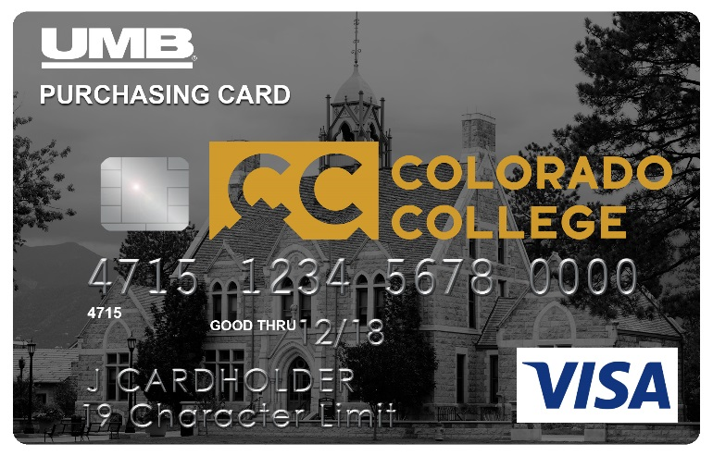
CARD DESIGN
Reduces “accidental” personal use
Immediate recognition with merchants that this a business card
Merchants do not automatically know the College is tax exempt - tell the merchant PRIOR to making the purchase
Tax exempt number is printed on the face of new cards, but you still have to tell the merchant

Slide 8
CARDHOLDER LIMITS
CARDHOLDER LIMITS
LEVEL I $2,500 single $5,000 monthly | CENTRALIZED PURCHASE CARD (IT, Facilities, Purchasing) $25,000 single $50,000 monthly
LEVEL II $5,000 single $10,000 monthly | FLEET (limits determined by Transportation/ Department Head)
LEVEL lll $10,000 single $25,000 monthly
PROJECT/DECLINING BALANCE – ideal for the occasional traveler or infrequent purchaser

Slide 9
CARD EXPIRATION
Cards expire after four years
New cards are mailed to the Purchasing Department and you will receive an email asking you to pick it up there

Slide 10
IF YOU TRAVEL…
The UMB Bank VISA Procurement Card has Worldwide Automatic Travel Accident & Baggage Delay Insurance Coverage
Full death benefit amount $500,000
Up to $100 per day for 3 days in the event of a Baggage Delay
See your P-Card packet for additional details.

Slide 11
TRAVEL NOTIFICATION
If you plan to travel Abroad, notify the Purchasing Department by email (at least a week, but no more than 30 days before):
  your dates of travel
  and the countries you will be visiting
This allows us to alert the FRAUD team for UMB to avoid any suspension of your card

Slide 12
UMB COMMERCIAL CARD
UMB Commercial Cards = Online Reconciliation Tool
Cardholders or their delegates complete reconciliation (coding) on UMB Commercial Card by the 8th (except in January). The deadline is always posted on the right-hand side of the home page on UMB Commercial Card
Department Heads complete approval of transactions on UMB Commercial Card
Department Head = cardholder’s immediate supervisor (to whom do you report?), manager, director, department chair, vice president, president (depends on the cardholder’s title or position)

Slide 13
RECONCILIATION
The act of assigning the appropriate budget code (FOAP- Fund, Org, Account, Program) to each transaction
Description of the transaction (who, what, where, when and why)
Indicate whether or not you have a receipt
Reconciliation must be completed on a monthly basis as per the dates shown on the UMB Commercial Card home page (always the 8th, except in January) Helpful hint: put the 6th in your calendar

Slide 14
Reconciliation-Fraud/Dispute processes
Fraud Process
Fraudulent charges are found either by you or the VISA Fraud Department
  The Fraud Department of VISA or the P-Card Program Administrator may contact the Cardholder to verify and confirm any questionable charges.
    For fraudulent transactions that are not authorized by the cardholder, UMB will mail a fraud form to the cardholder to complete and return to the fax number listed on the form.
    All fraud transactions (and any associated credits or adjustments) must be reconciled and credited to Account code 708995.
    UMB will close the account and reissue a new card that will be delivered to the Purchasing Department within 7-10 business business days.
Dispute Process
The dispute process applies when there is a duplicate charge or an unauthorized transaction
  A dispute form (available on the Finance & Administration website) must be completed.
    All disputed charges (and any associated credits or adjustments) must be reconciled to Account code 708995.
Assigning the Account code (708995) to a transaction, does not automatically initiate a credit from the bank nor the closing of the current account and reissue of a new card. If the cardholder notices fraudulent transactions, the cardholder must notify the UMB using the phone number on the back of the P-Card.

Slide 15
RECEIPT IMAGING PROCESS
Photograph or scan your receipts and upload them to a file on your desktop for later reconciling
UMB Commercial Card offers the ability to scan or email your receipts into an Image Library to be linked to transactions
  The approver may view receipts as needed
  Paper receipt retention unnecessary when this method is used

Slide 16
APPROVALS
Department Heads
  Responsible for reviewing and approving cardholder transactions on a monthly basis electronically via UMB Commercial Card
  May request additional details from cardholders for specific transactions prior to approval
Approval and review of transactions MUST be conducted by the cardholder’s supervisor and NOT by a peer. Some Department Heads may elect to have staff review and approve cardholder transactions prior to actual Department Head review – this is done at the discretion of the Department Head and is not a requirement of the Procurement Card program.

Slide 17
CARDHOLDER RESPONSIBILITIES
Make purchases in compliance with Colorado College expenditure policies and departmental preferences
Retain all receipts for purchases made with the P-Card until scanned. If not scanned, then paper retained for 7 years
Reconcile all transactions in a timely manner
  NOTE: if someone else in your department reconciles for you, ensure that your receipts are turned in to the reconciler well before the deadline
***If you know you will not be using your card for an extended period of time (summer vacation, sabbatical, FLMA time off), notify the Purchasing Department to decrease your credit limit

Slide 18
LIMIT INCREASES
Limit increases can be permanent or temporary – Cardholder must make a request via email for increases and copy their supervisor for their approval
Limit increases will be processed from 8:00am-5:00pm on weekdays. As with any Finance Office requests, they will be processed on a first-come, first-served basis within 5 days of receipt of the request

Slide 19
RECEIPTS and the FIVE W’s
A receipt is required for EVERY transaction over $25 made with the College P-Card, but as many receipts as possible should be attached to transactions (even if the transaction is less than $25)
Receipts must be kept on file for seven years, per IRS requirements
Each transaction in UMB Commercial Card should detail the following information:
  Who (vendor name)
  What (items purchased)
  Where (location of transaction)
  When (date of transaction)
  Why (purpose of the transaction)

Slide 20
MISSING RECEIPTS
A Missing Receipt Affidavit is included in the training documents you will be sent. A copy of the affidavit can also be found on the Finance & Administration website
The affidavit requires the department head’s signature and the 5-Ws of the transaction
  Upload the affidavit to the pertinent transaction as documentation

Slide 21
REIMBURSEMENT
REIMBURSEMENT FOR PERSONAL PURCHASES
Use Account code 708993 and state “P-Card Used in Error for Personal Expense” in the description for the transaction
Submit reimbursement to the College within 30 calendar days and attach the receipt from the Cashier to your original receipt. Please retain this with your records
When submitting a check to the College, use the same FOAP that was used when reconciling the transaction in UMB Commercial Card

Slide 22
PROHIBITED PURCHASES
PERSONAL PURCHASES!!!
Purchases that are centralized on campus (i.e., IT, Facilities, Business Office/Purchasing), such as technology equipment, copiers, and furniture
Services of any kind associated with a scope of work or contract (exceptions: Facilities/Business Office)
Insurance (exception: insurance for airfare or vehicle rentals or when traveling abroad - verification of CC insurance should be requested from the Executive Assistant for Finance)
Fines or court costs | Cash advances of any type
Cellular phones and related monthly charges | Capital equipment Gift cards over $50 each
Leases and lease-purchases Honorariums | Technology equipment (i.e., computers and peripherals)
Dating and escort services | Casinos, Furriers, Massage parlors
Time payments of any type (includes subscriptions) Personal items | Donations to organizations (non-profit or for-profit)
** SEE POLICIES & PROCEDURES MANUAL REGARDING CONSEQUENCES FOR CARD MISUSE **

Slide 23
ONLINE PURCHASES
Online Purchases
  Be sure you are ordering from a secure site
  in the address bar the website should read: https: instead of just http...the "s" stands for secure.
Protect your procurement card:
  Do not share your card or account information
  Do not email or fax your cardholder account information: call it in instead
  Immediately contact the Purchasing Department in the event of a lost or stolen card
  Do not store passwords

Slide 24
AFTER THE TRAINING SESSION
Activate your card upon receipt
Log into UMB Commercial Card (the reconciliation tool)
https://identity.commercialcard.umb.com/login?signin=9fa99bb3bd63fcbe8fe1b4f3cd3d7995#/login
  Contact Purchasing if you require assistance
You will receive an email with policies, information about UMB Commercial Card & reconciliation and tax exemption certificates

Slide 25
AND FINALLY…
Issuance of a UMB VISA Procurement Card is a relationship of trust between you and the College
The card is a privilege granted to you by the College, and you are charged with responsible use of the card
All purchases must be made in compliance with CC expenditure policies
Expenditure of funds is held to the highest degree of trust amongst the institution
Fraudulent or intentional misuse of the card will result in revocation of the card and possible additional disciplinary action.

Slide 26
WRAP-UP/Q&A
COLORADO COLLEGE
Anne Corley
Administrative Services Specialist
Procurement Card Administrator
(719) 389-6695
acorley@coloradocollege.edu
UMB Bank/VISA
To report a lost or stolen card
24 hours a day worldwide customer service
(888)494-5141

Slide 27
QUIZ
True or False:
A receipt is required only for purchases over $25
Where are monthly reconciliation deadlines posted?
What is the monthly deadline for reconciliation?
Who approves and reviews monthly P-Card transactions for cardholders?

Slide 28
QUIZ…cont’d
True or False:
  I may let others use my P-Card for college-related business purposes
  Receipts need to be retained for a period of three years per IRS requirements
  The P-Card is valid for four years
  I may use the P-Card to make personal purchases as long as I reimburse the College in a timely manner

Slide 29
QUIZ…cont’d
If I need a limit increase, I need to:
  Contact UMB customer service
  Call the CC Purchasing Office
  Submit my request for a limit increase in writing to the administrator & cc your supervisor
If I want to email my card account information, I may include all pertinent data in the email. True or False?

Slide 30
QUIZ…cont’d
True or False:
  The College P-Card is a tool that all staff and faculty have a right to use
  The UMB P-Card program covers $200 per day for up to three days in the event of a baggage delay
  Unauthorized use or abuse of the P-Card is subject to termination of employment
  The College’s tax exempt status is automatically registered when the P-Card is swiped on vendor point-of-sale terminals

